Slide 1
Team WebPros
Web Programming 4370 group project
Jeopardy!

Slide 2
Jeopardy!
For our group project we made a Jeopardy style game to play online.
Team WebPros is:
Jay Limbasia: Lead programmer, Designer, Tester
Farhana Chadni: Programmer, Home Page Designer, Tester
Patrick Davis: Team leader, Programmer, Tester

Slide 3
Our game will allow the player to select from different categories with varying levels of values and difficulty.
It was created with HTML, PHP, and CSS files.

Slide 4
Home Page

Slide 5
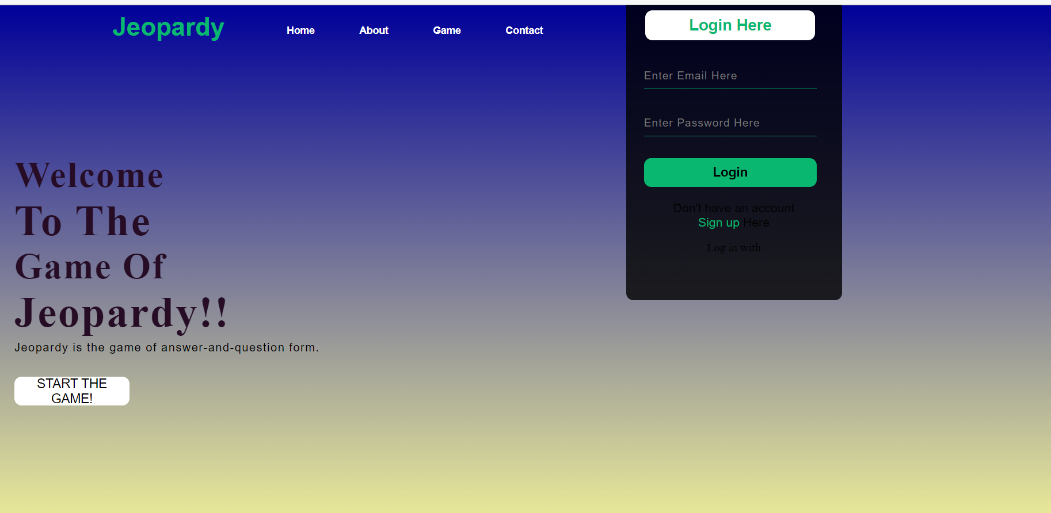

Slide 6
<!DOCTYPE html>
<html>
<head>
<meta charset="utf-8">
<meta name="viewport" content="width=device-width, initial-scale=1">
<title>HOME</title>
<link rel="stylesheet" href="style.css">
</head>
<body>
<div class="main">
<div class="navbar">
<div class="icon">
<h2 class="logo">Jeopardy</h2>
</div>
<div class="menu">
<ul style="list-style: none;">
<li><a href="#">Home</a></li>
<li><a href="#">About</a></li>
<li><a href="#">Game</a></li>
<li><a href="#">Contact</a></li>
</ul>
</div>
</div>
<div class="content">
<h1> Welcome <br><span> To The </span> <br>Game Of <br><span>Jeopardy!!</span></h1>
<p class="par"> Jeopardy is the game of answer-and-question form. </p>
<button class="cn"><a href="#"> START THE GAME!</a></button>
<div class="form">
<h2>Login Here</h2>
<input type="email" name="email" placeholder="Enter Email Here">
<input type="password" name=" " placeholder="Enter Password Here">
<button class="btnn"><a href="#">Login</a></button>
<p class="link">Don't have an account<br>
<a href="#">Sign up </a> Here</a></p>
<p class="liw">Log in with</p>
</div>
</div>
</body>
</html>

Slide 7
<div class="content">
<h1> Welcome <br><span> To The </span> <br>Game Of <br><span>Jeopardy!!</span></h1>
<p class="par"> Jeopardy is the game of answer-and-question form. </p>
<button class="cn"><a href="#"> START THE GAME!</a></button>
<div class="form">
<h2>Login Here</h2>
<input type="email" name="email" placeholder="Enter Email Here">
<input type="password" name=" " placeholder="Enter Password Here">
<button class="btnn"><a href="#">Login</a></button>
<p class="link">Don't have an account<br>
<a href="#">Sign up </a> Here</a></p>
<p class="liw">Log in with</p>
</div>
</div>
</body>
</html>

Slide 8
Game Board

Slide 9
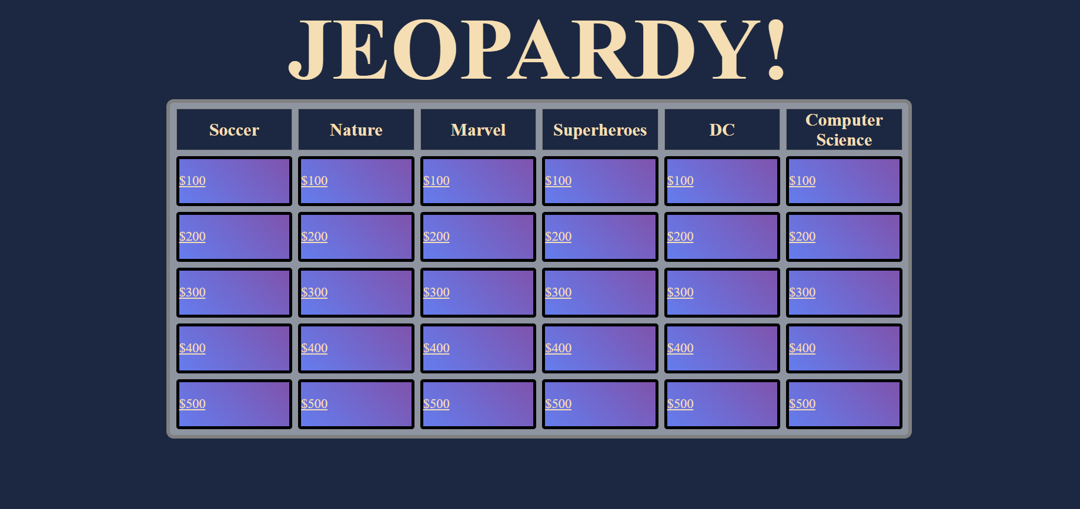

Slide 10
<!DOCTYPE html>
<html lang="en">
<head>
<meta charset="UTF-8">
<meta http-equiv="X-UA-Compatible" content="IE=edge">
<meta name="viewport" content="width=device-width, initial-scale=1.0">
<title>Jeopardy!</title>
<link rel="stylesheet" href="jeopardy_boardStyle.css">
<body>
<table CELLSPACING=8>
<caption>
<h1 id="cap-style">JEOPARDY!</h1>
</caption>
<tr>
<th>Soccer</th>
<th>Nature</th>
<th>Marvel</th>
<th>Superheroes</th>
<th>DC</th>
<th>Computer Science</th>
</tr>

Slide 11
<tr>
<td class="button"><a href="soccer_100.php">$100</a></td>
<td class="button"><a href="nature_100.php">$100</a></td>
<td class="button"><a href="marvel_100.php">$100</a></td>
<td class="button"><a href="Superheroes_100.php">$100</a></td>
<td class="button"><a href="DC_100.php">$100</a></td>
<td class="button"><a href="cs_100.php">$100</a></td>
</tr>
<tr>
<td class="button"><a href="soccer_200.php" >$200</a></td>
<td class="button"><a href="nature_200.php">$200</a></td>
<td class="button"><a href="marvel_200.php">$200</a></td>
<td class="button"><a href="Superheroes_200.php">$200</a></td>
<td class="button"><a href="DC_200.php">$200</a></td>
<td class="button"><a href="cs_200.php">$200</a></td>
</tr>
<tr>
<td class="button"><a href="soccer_300.php">$300</a></td>
<td class="button"><a href="nature_300.php">$300</a></td>
<td class="button"><a href="marvel_300.php">$300</a></td>
<td class="button"><a href="Superheroes_300.php">$300</a></td>
<td class="button"><a href="DC_300.php">$300</a></td>

Slide 12
<td class="button"><a href="cs_300.php">$300</a></td>
</tr>
<tr>
<td class="button"><a href="soccer_400.php">$400</a></td>
<td class="button"><a href="nature_400.php">$400</a></td>
<td class="button"><a href="marvel_400.php">$400</a></td>
<td class="button"><a href="Superheroes_400.php">$400</a></td>
<td class="button"><a href="DC_400.php">$400</a></td>
<td class="button"><a href="cs_400.php">$400</a></td>
</tr>
<tr>
<td class="button"><a href="soccer_500.php">$500</a></td>
<td class="button"><a href="nature_500.php">$500</a></td>
<td class="button"><a href="marvel_500.php">$500</a></td>
<td class="button"><a href="Superheroes_500.php">$500</a></td>
<td class="button"><a href="DC_500.php">$500</a></td>
<td class="button"><a href="cs_500.php">$500</a></td>
</tr>
</body>
</html>

Slide 13
Sign Up Page

Slide 14
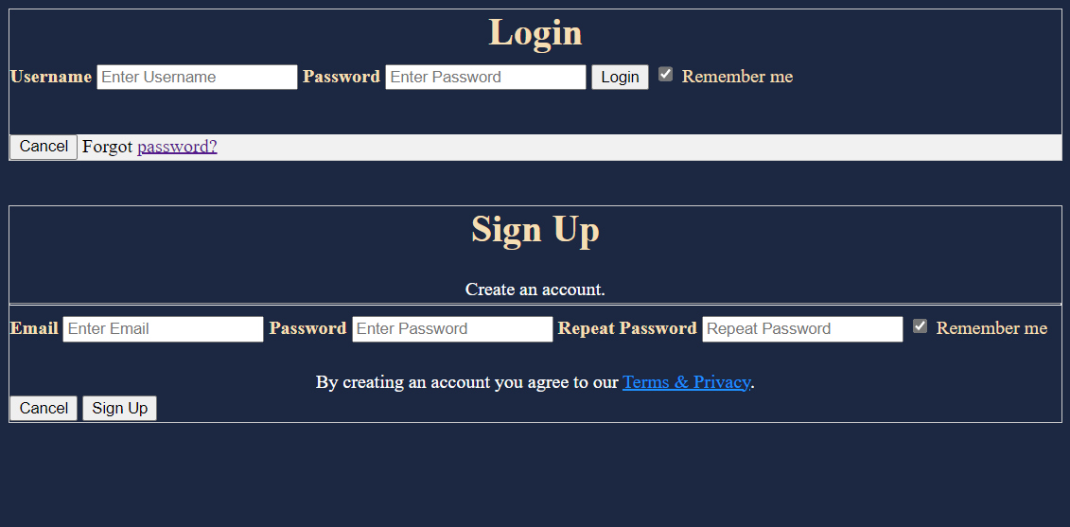

Slide 15
<!DOCTYPE html>
<html>
<link rel="stylesheet" href="sign_up.css">
<form action="action_page.php" method="post" style="border:1px solid #ccc">
<div class="container">
<h1>Login</h1>
<label for="uname"><b>Username</b></label>
<input type="text" placeholder="Enter Username" name="uname" required>
<label for="psw"><b>Password</b></label>
<input type="password" placeholder="Enter Password" name="psw" required>
<button type="submit">Login</button>
<label>
<input type="checkbox" checked="checked" name="remember"> Remember me
</label>

Slide 16
<p></p>
</div>
<div class="container" style="background-color:#f1f1f1">
<button type="button" class="cancelbtn">Cancel</button>
<span class="psw">Forgot <a href="#">password?</a></span>
</div>
</form>
<p></p>
<form action="action_page.php" style="border:1px solid #ccc">
<div class="container">
<h1>Sign Up</h1>
<p>Create an account.</p>
<hr>
<label for="email"><b>Email</b></label>
<input type="text" placeholder="Enter Email" name="email" required>
<label for="psw"><b>Password</b></label>
<input type="password" placeholder="Enter Password" name="psw" required>

Slide 17
<label for="psw-repeat"><b>Repeat Password</b></label>
<input type="password" placeholder="Repeat Password" name="psw-repeat" required>
<label>
<input type="checkbox" checked="checked" name="remember" style="margin-bottom:15px"> Remember me
</label>
<p>By creating an account you agree to our <a href="#" style="color:dodgerblue">Terms & Privacy</a>.</p>
<div class="clearfix">
<button type="button" class="cancelbtn">Cancel</button>
<button type="submit" class="signupbtn">Sign Up</button>
</div>
</div>
</form>
</html>

Slide 18
Questions? & Answers!

Slide 19
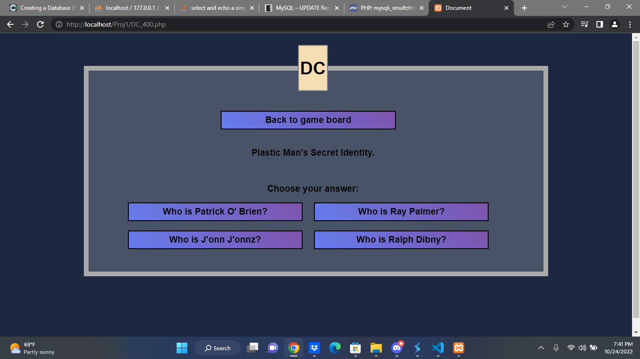

Slide 20
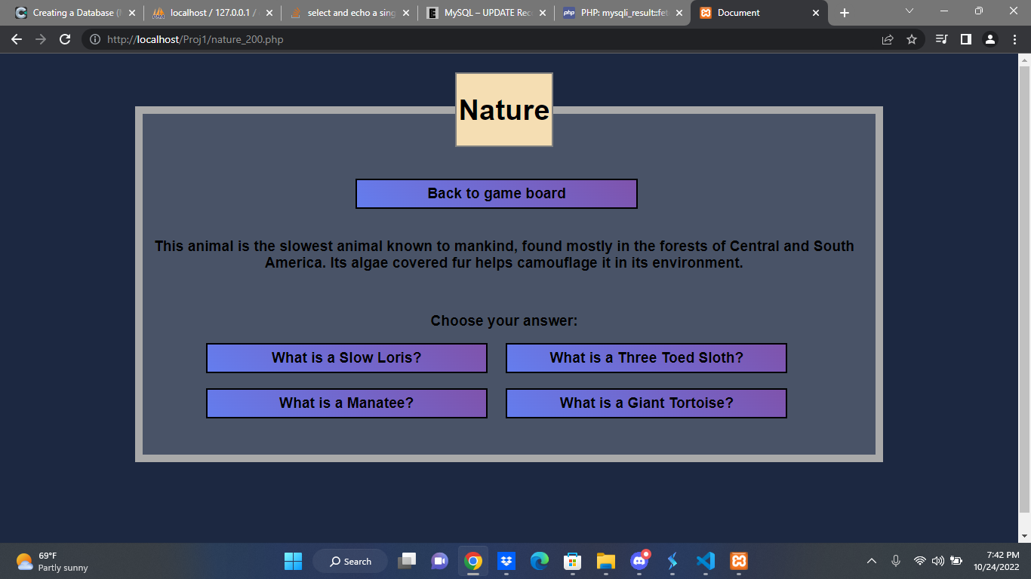

Slide 21
*{
font-family: "Open Sans", "DejaVu Sans", sans-serif
}
html, body{
height: 100%;
}
body{
background-color: #1c2841;
}
fieldset{
border: 10px solid darkgray;
background: rgb(255,255,255, 0.2);
width: 70%;
height: 50%;
margin: 25px auto auto;
text-align: center;
padding-right: 25px;
}
p, label, input[type=submit], legend{
font-size: larger;
font-weight: bold;
}

Slide 22
legend{
border: 2px solid gray;
background-color: wheat;
}
input[type = submit]{
width: 40%;
height: 40px;
margin-bottom: 20px;
margin-right: 20px;
background: linear-gradient(45deg, #647DEE, #7F53AC);
cursor: pointer;
}
input[type = submit]:hover{
transform: scale(1.1, 1.1);
background: lightskyblue;
box-shadow: 1px 8px 5px black;
}
.correct{
background-color: lightgreen;
}
.wrong{
background-color: rgba(255, 0, 0, 0.78);
}

